Slide 1


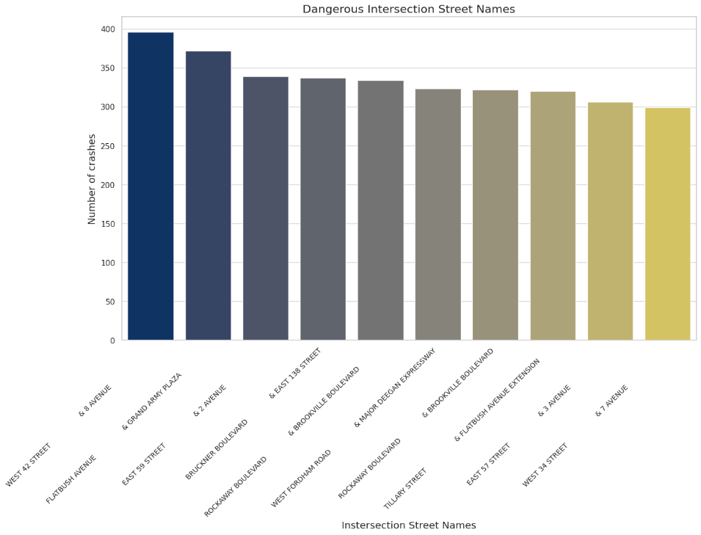
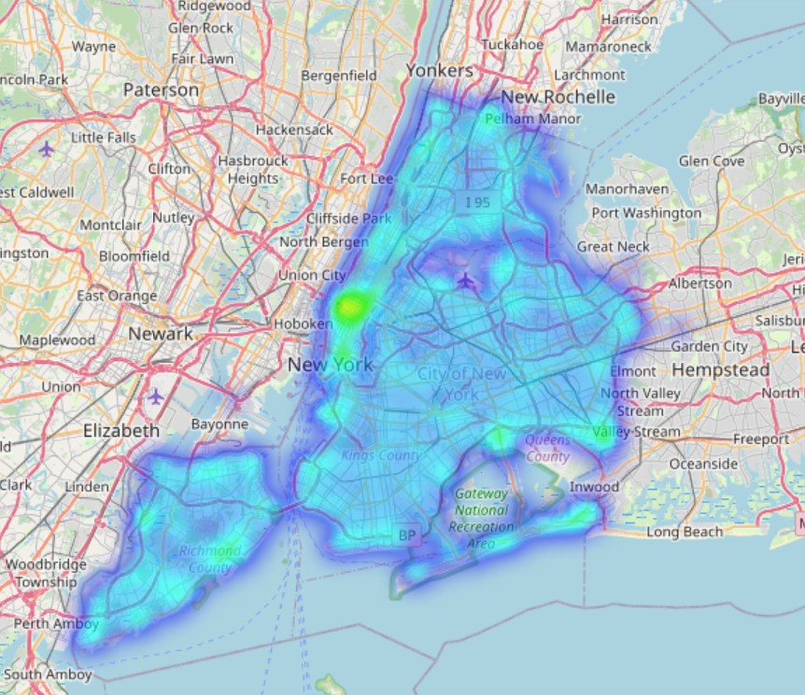
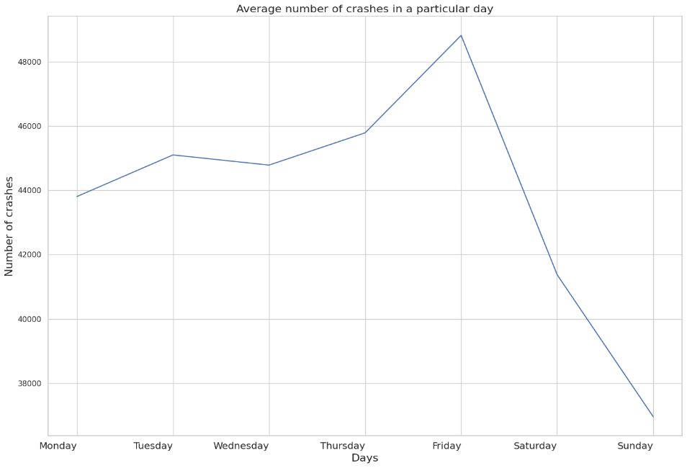
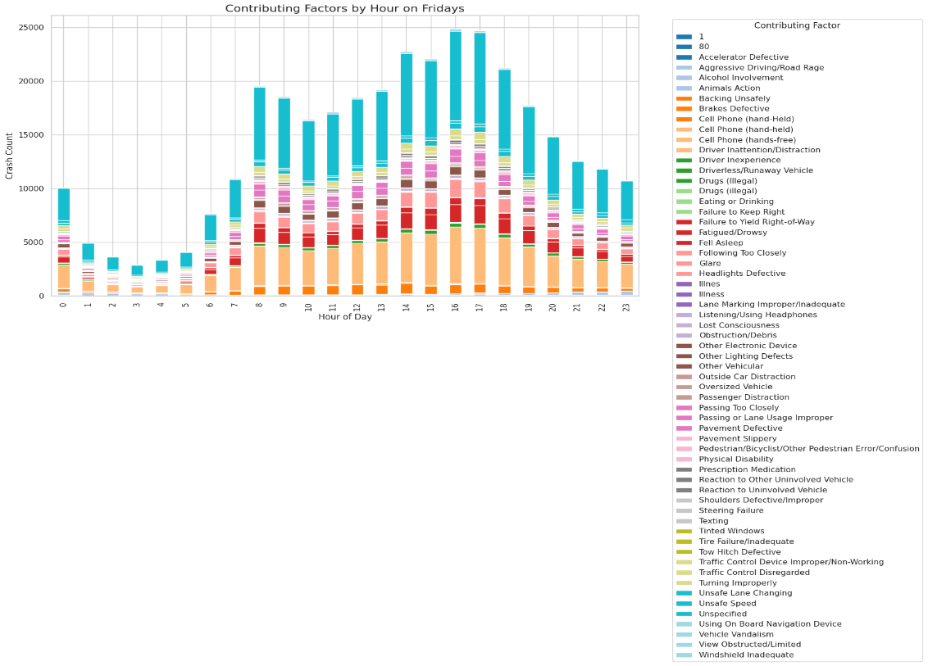
NEW YORK CITY CAR CRASHES- TRANSPORTATION DATA SCIENCE PROJECT
CRASH PROBABILITY PER DAY
EATHOMOKKALA GOWTHAM VENKAT
MASTER OF SCIENCE, ADVANCED DATA ANALYTICS
UNIVERSITY OF NORTH TEXAS, DENTON, TEXAS
DANGEROUS INTERSECTIONS
Because there are so many intersections, there may be some hazardous ones that could result in collisions. Using the bar plot, I have displayed the top ten hazardous intersections where the majority of crashes occurred based on my findings.
I propose that the transportation department increase lanes or lower the speed limit at particular intersections to take the appropriate safety measures..
CRASH PROBABILITY ON A DAY
I want to highlight the day with the highest number of auto accidents. To compare the days of the week, I created a line chart. As we can see, Friday has more crashes.
Since Friday is the weekend, people prefer to head home and unwind after work. They will, therefore, rush to leave, which may result in mishaps. Additionally, I made a bar chart that shows the times at which the majority of crashes happen as well as the elements that contribute to those crashes at those periods.
Additionally, I propose that the transportation agency offer tollway reductions, which can help with heavy traffic on typical days. People will undoubtedly use this as there will be discounts, allowing them to move quickly while spending less. Additionally, To clear the direction with the most traffic first, a police officer should also be assigned to the busiest crossroads.
Fig 1: Bar Plot of Dangerous Intersections
Fig 2: Heat Map of Dangerous Intersections
Fig 3: Average crashes on a day.
I have selected the aforementioned questions to lower the number of collisions; the first one will assist in identifying the hazardous intersection. in order for the transportation agency to pay more attention to certain intersections and implement preventative measures. The average number of crashes in a day is suggested by the second one with also the contributing factors on Friday. Authorities can concentrate on lowering crashes on a certain day if they know which day has the highest number of crashes.
Fig 4: Factors that contributed to Friday's crashes based on the time

